Slide 1
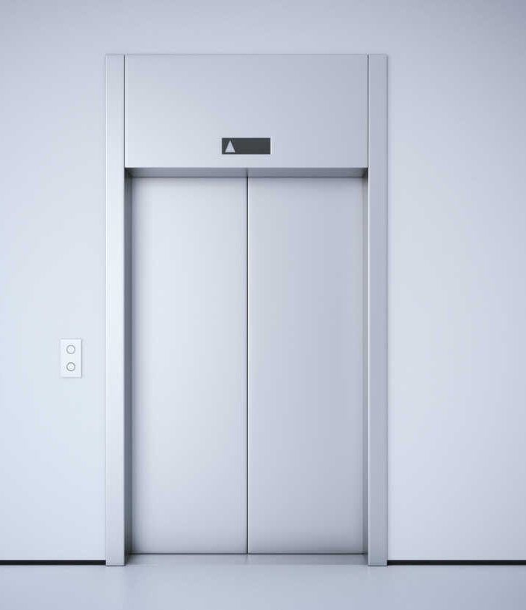
Elevator Optimising
Deep Learning Hackathon
30 Sept 2022 – 3 Oct 2022
sword_turing Team (Brief video: https://youtu.be/utA7Va1xaNg) Gong Zerui, Bryan Lu We Zhern, Aden Ong Yew, Chang Chieh Hsiang, Chang Ren You

Slide 2
Problem Statement and Aim
01
Traditional elevators do not factor in the usage of the elevators based on time or events. For example, office buildings’ elevators would be frequently used during peak hours such as start of work, lunch and end of work, which would increase the traveling time needed for workers to get to their office. Despite more and more elevator companies concerned about how their elevator's functionality, not all of their products are running with IoT devices embedded.
We want to provide a solution that can be retrofitted to any existing elevator and provide companies with a range of data about user experience and elevator performance

Slide 3
Current Elevator Algorithm
02
First Come First Serve (FCFS)
Whichever floor presses the button first, the lift would be sent there first, and the order continues
This would cause the elevator to have the highest distance travelled
Shortest Seek Time First (SSTF)
The elevator would travel to the next closest request from its current position
This would reduce the distance travelled. However, floors at the extreme ends would have a very high waiting time
SCAN
When going up/down, it would travel to the next closest request in the direction of the elevator
Although SCAN has a higher distance travelled compared to SSTF, it does not have extreme wait times
Taking requests : 51 64 56 66 17 88 59 12 29 9 as example. Assuming elevator is at the 13 floor
Total distance travelled: 302
Sequence: 13 → 51 → 64 → 56 → 66 → 17 → 88 → 59 → 12 → 29 → 9
Total distance travelled: 83
Sequence: 13 → 12 → 9 → 17 → 29 → 51 → 56 → 59 → 64 → 66 → 88
Total distance travelled: 154
Sequence: 13 → 17 → 29 → 51 → 56 → 59 → 64 → 66 → 88 → 12 → 9

Slide 4
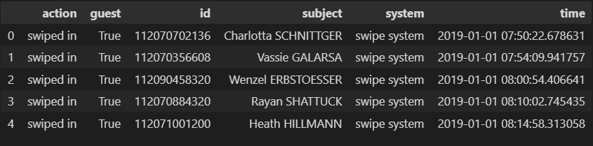
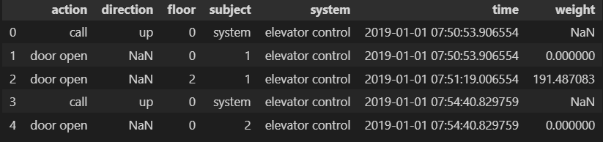
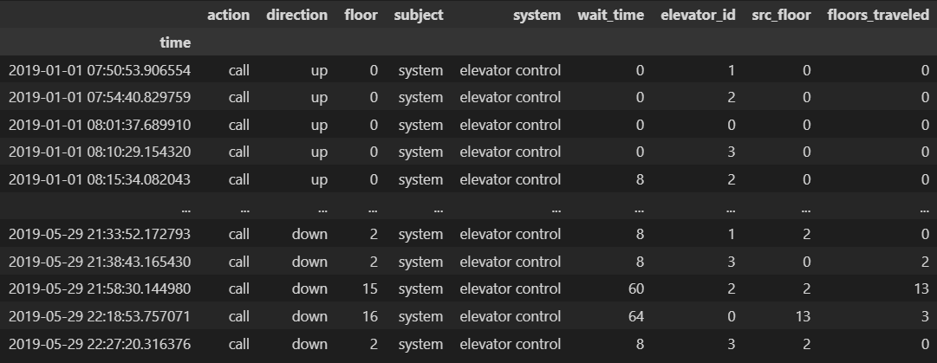
Dataset
03
people.csv dataset documented all of the swipes into the buildings security system
simulation.csv is a long of each elevator’s status and operations, there were total 4 elevators in the 20 story building.
With roughly equal numbers of up and down calls
Using this dataset, we reshape the data to what we need

Slide 5
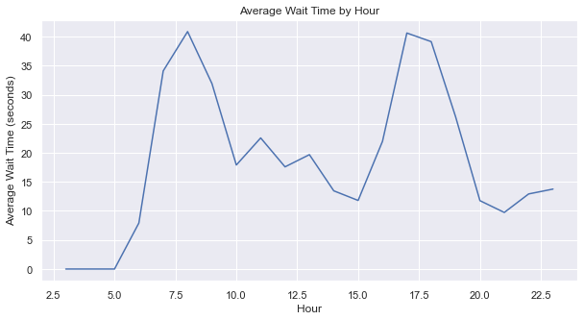
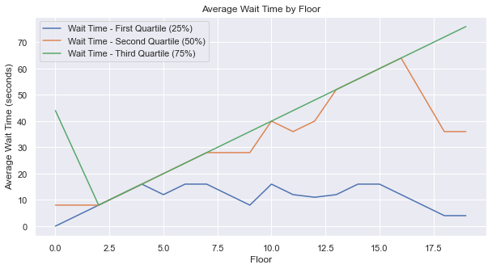
Using different EDA techniques, we discovered several trends that are important to answering our problem statement
The average wait time for the elevator peaks at certain periods of the day (start work and end work timing)
The average wait time spikes at around the 15th floor, as shown the by the orange line

Slide 6

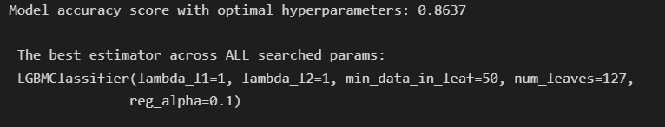
Model Training and Testing
04
Light-GBM model with RandomizedSearchCV for Hyperparameter Tuning
Predicts the likelihood of requests at every time instance
Using the model we are able to achieve a relatively high accuracy of 0.8637 with the above parameters.

Slide 7
Model Outcome and Thoughts
Despite our model performing at a high accuracy with our current dataset, relevant data from other sources are not readily available for training and testing purposes.
Besides, there are also many other factors that may affect the outcome of our model in real life, such as having multiple elevators, or different elevators design and layouts.
Therefore, due to technical and time constraints, our model might not be able to perform as well and as accurate in a real world scenario.

Slide 8
What We Hoped to Achieve
05
Despite the setbacks we faced, our analysis results showed that modern elevators clearly has room for improvement. And perhaps by using a simple embedded system in each elevator, data can be collected and processed through an algorithm to create a model that will minimise elevator waiting time. For example, multiple elevators can be programmed to serve certain levels where it’s expected to have high flow of people, or to have a better seeking algorithm to travel to the different floors.

